Slide 1
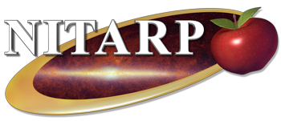
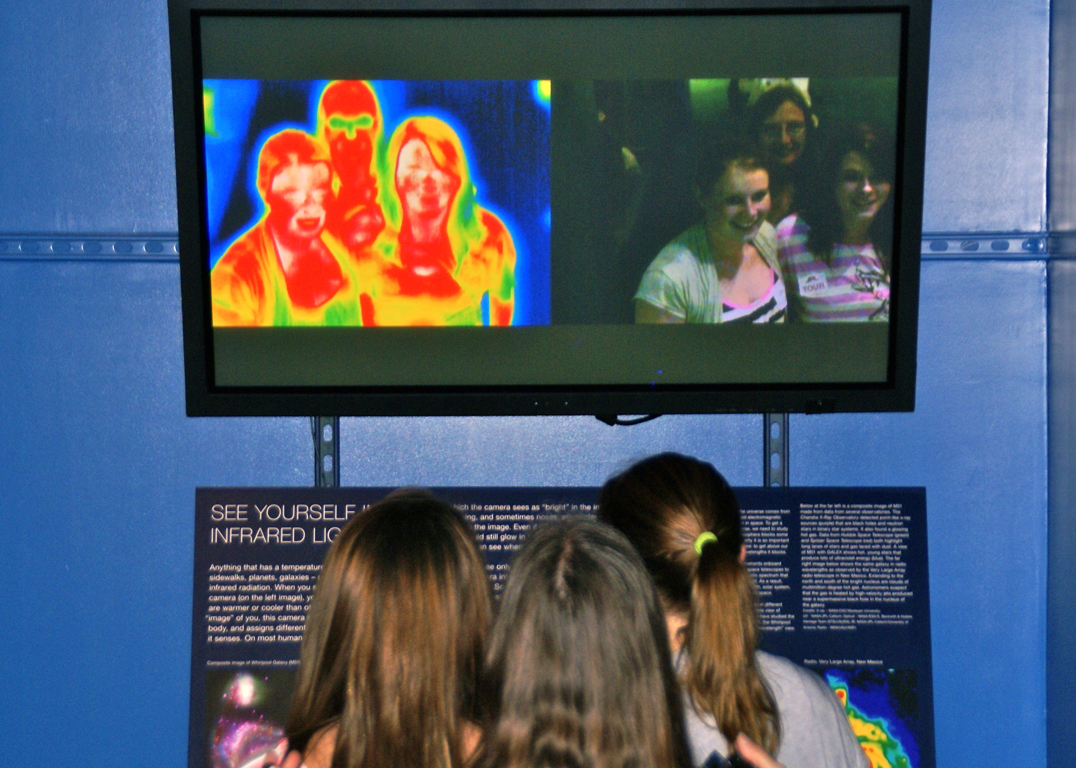
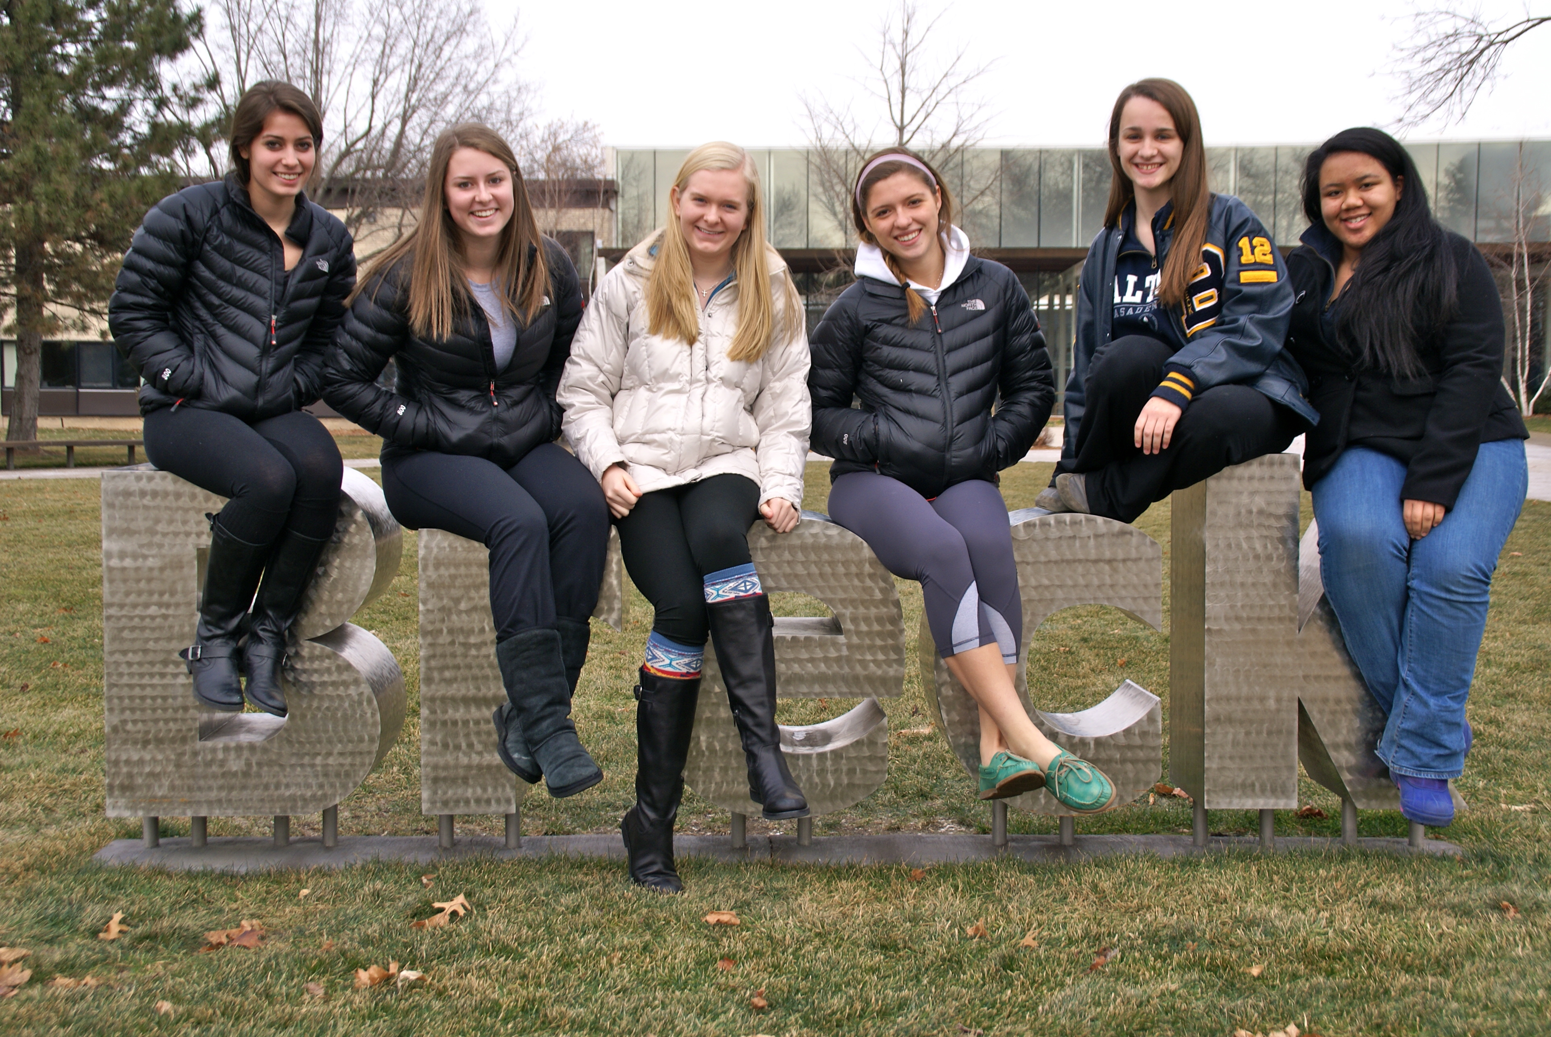
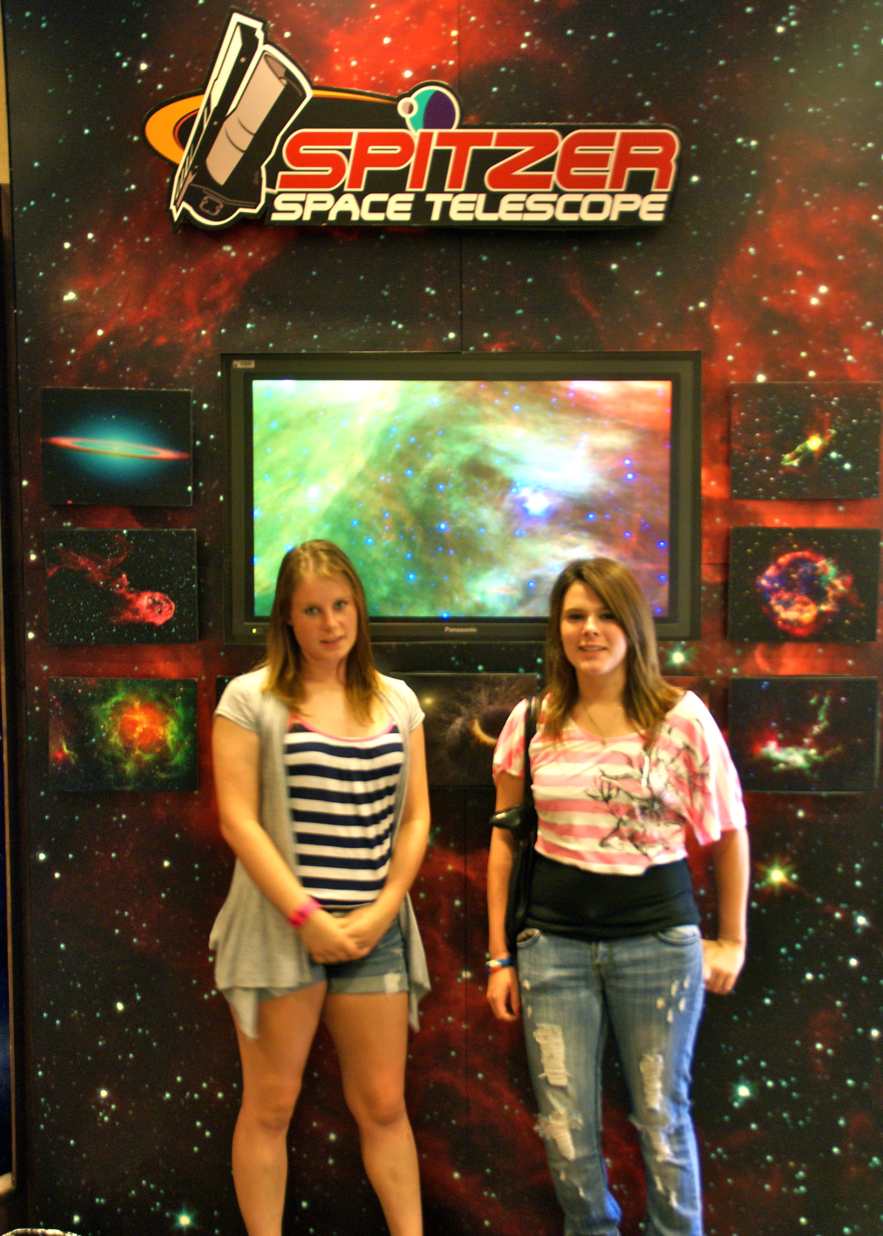
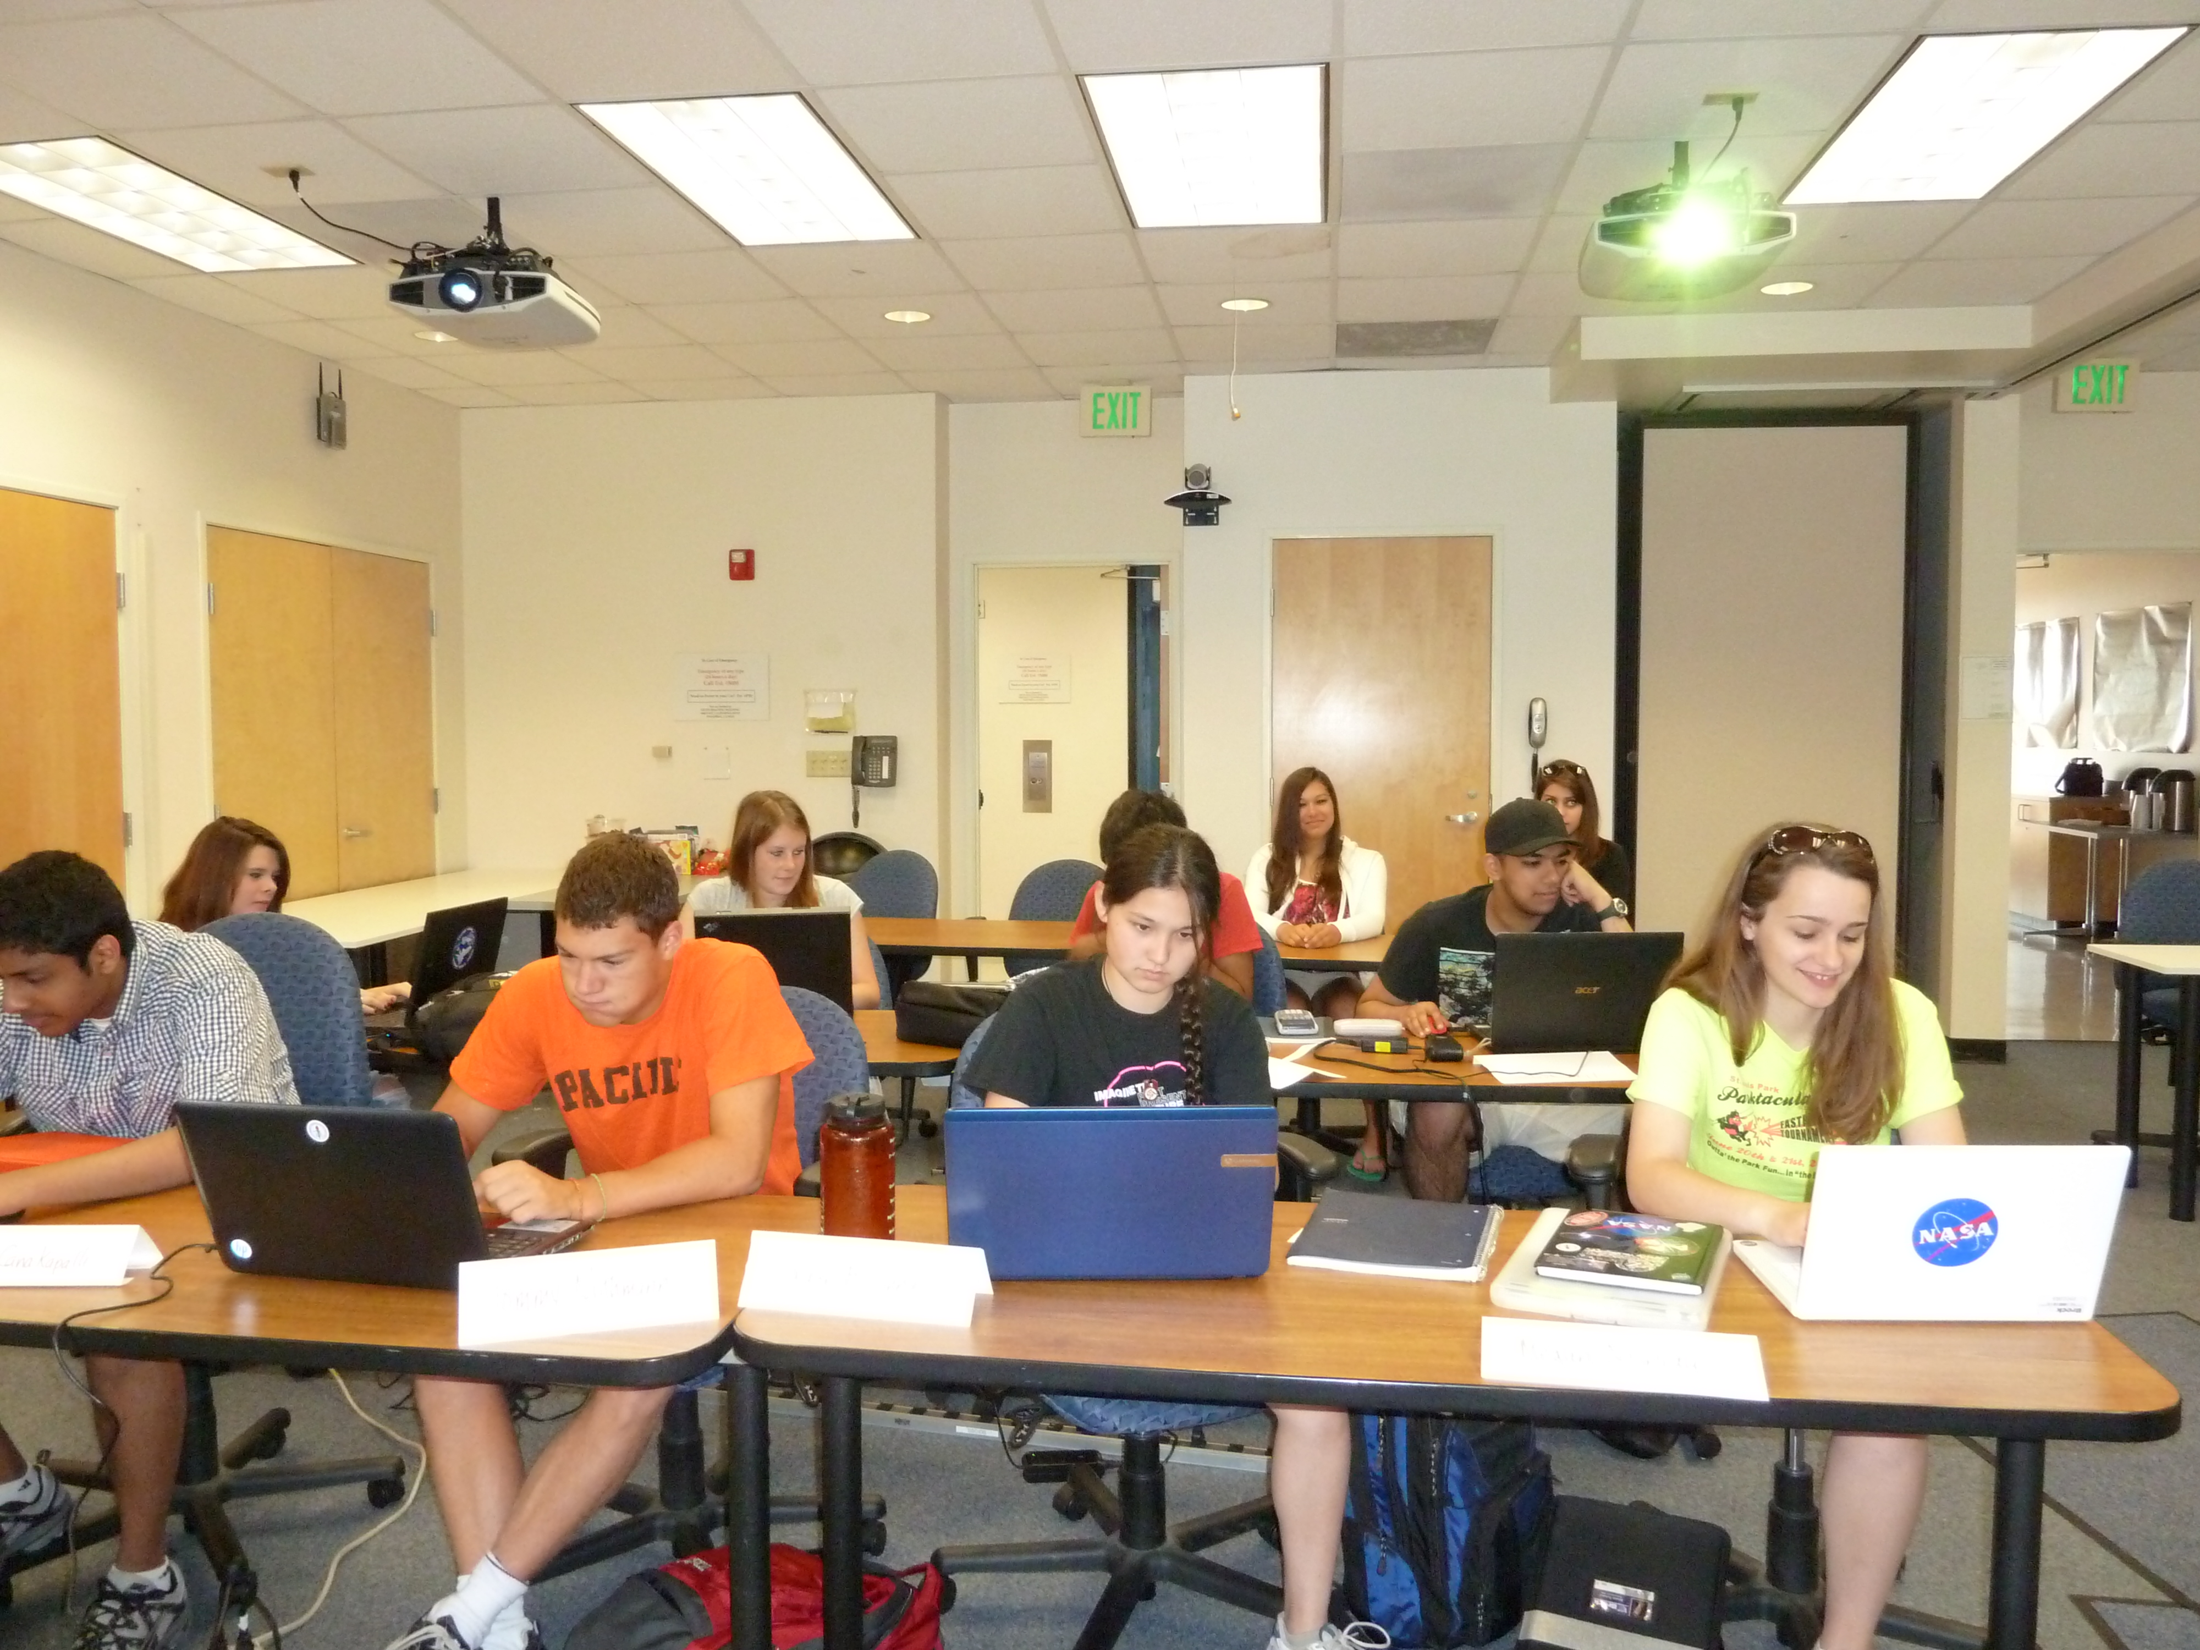
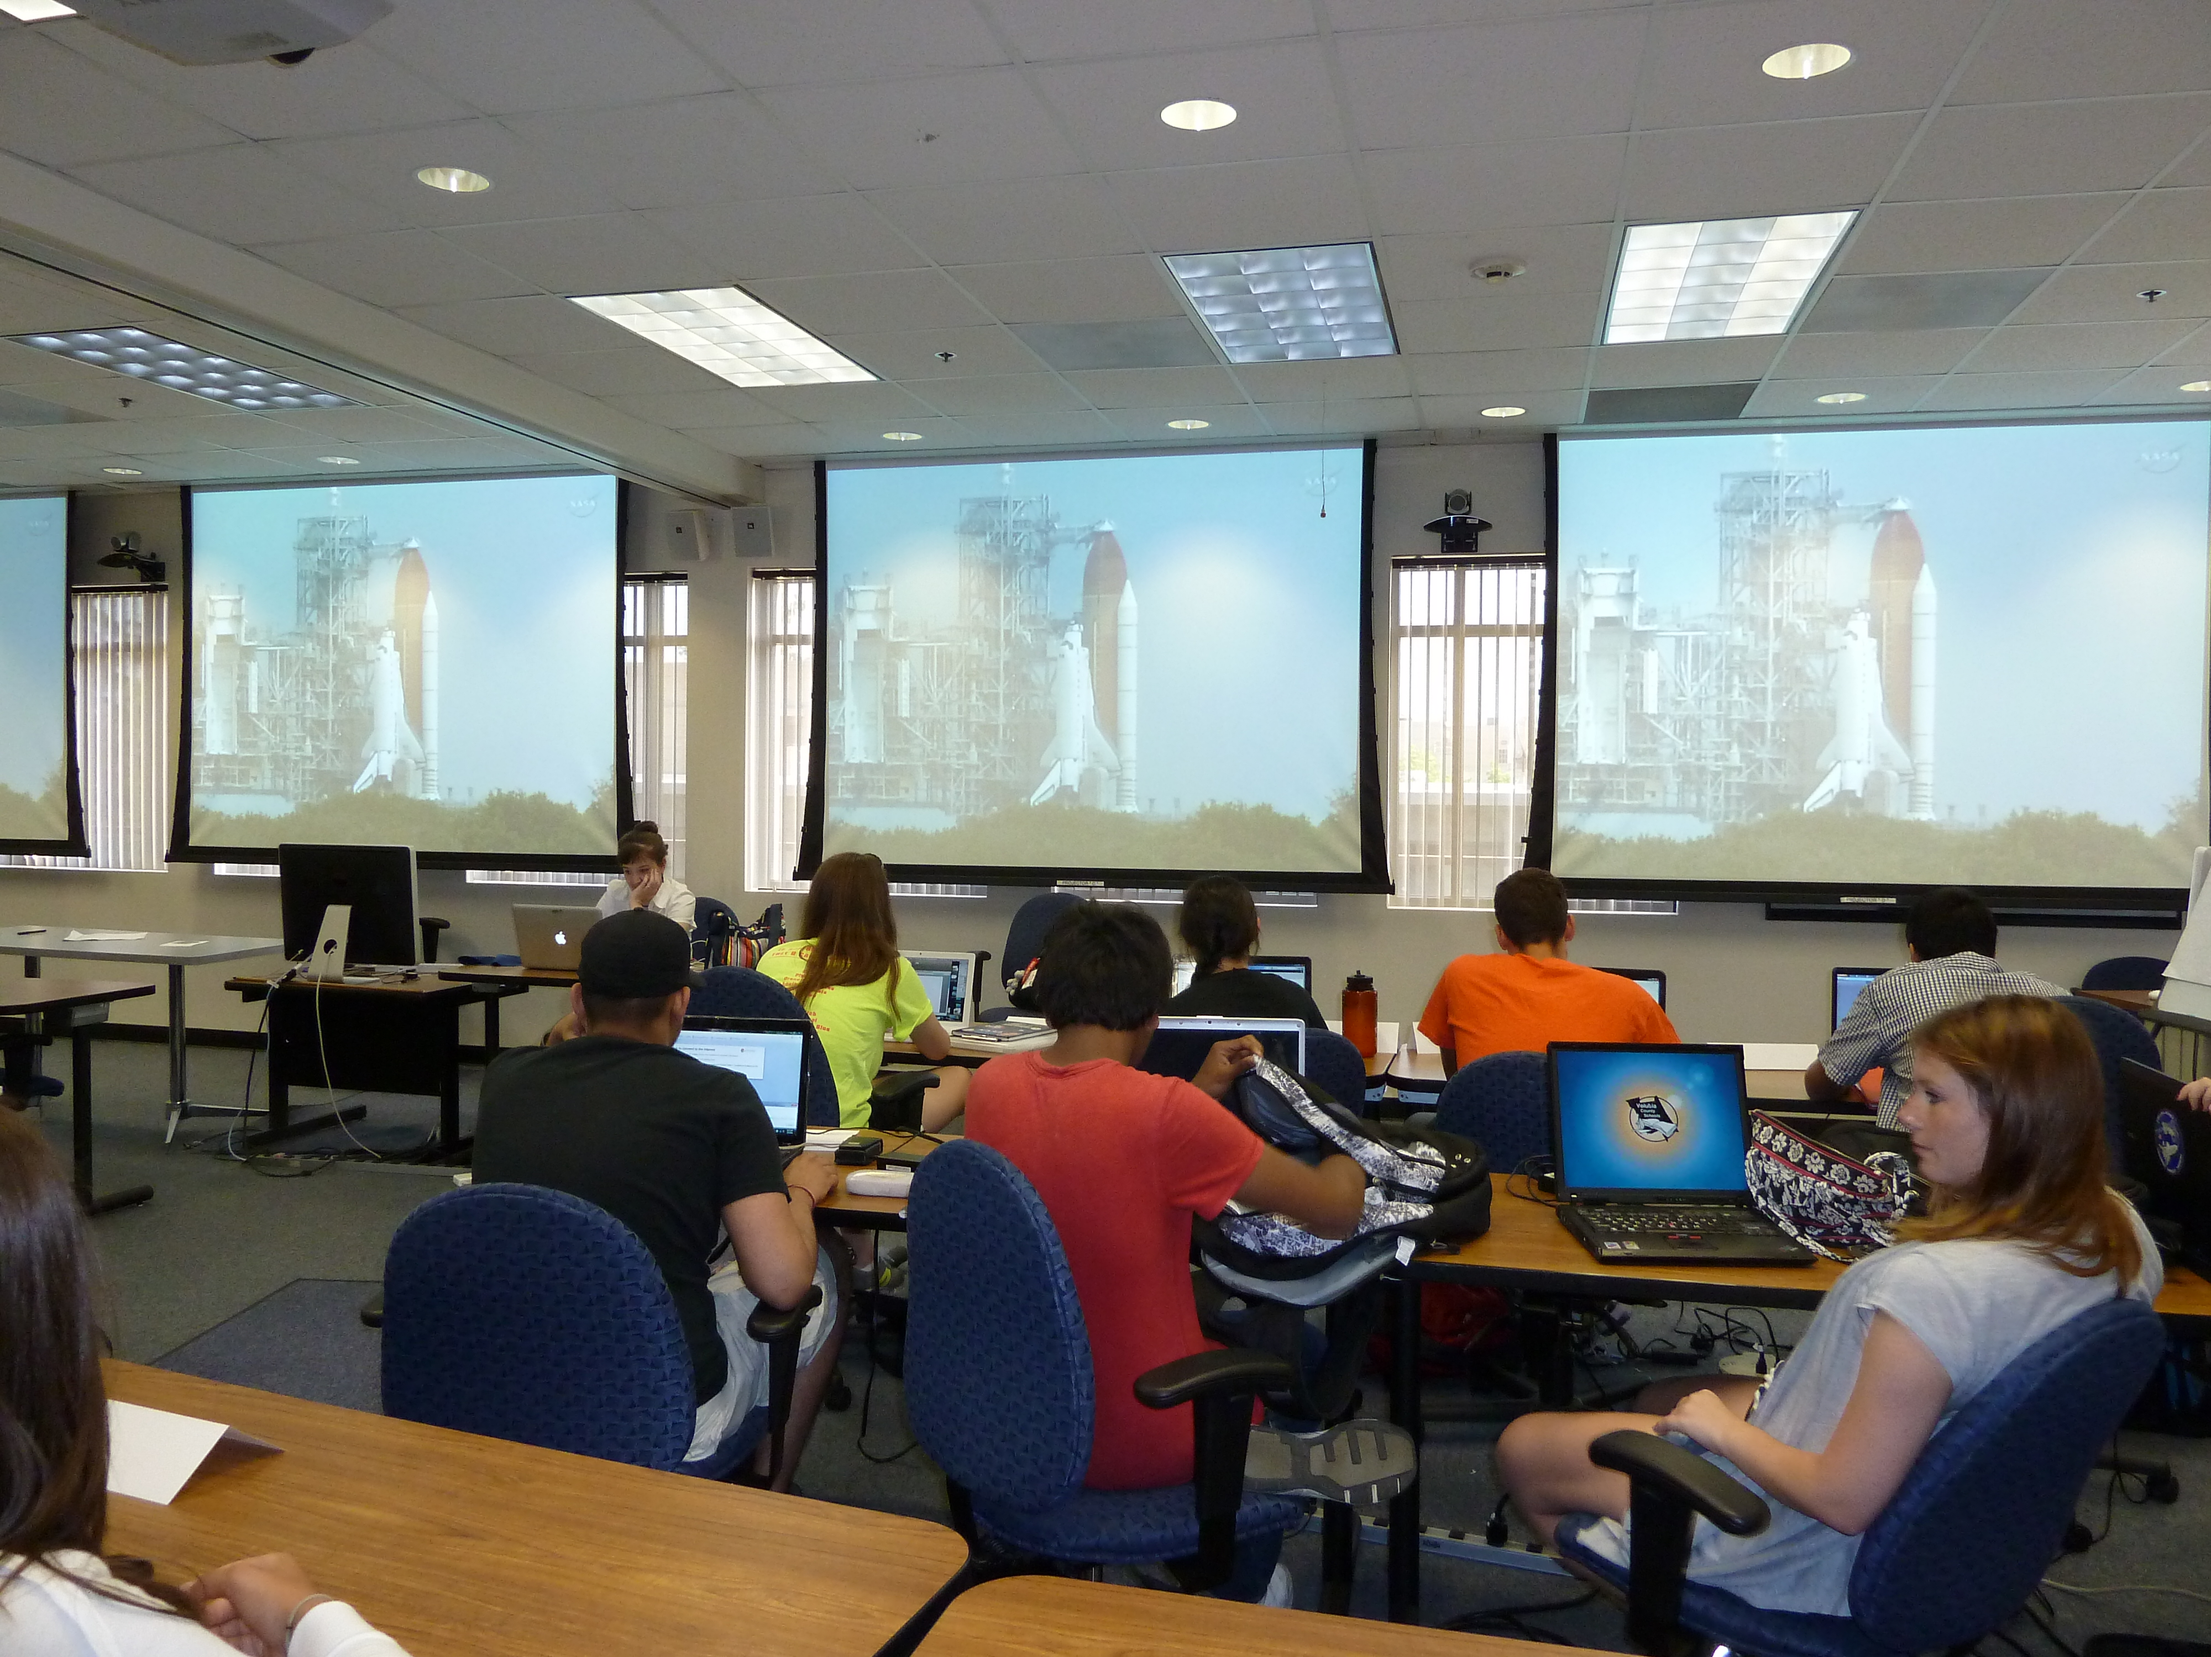
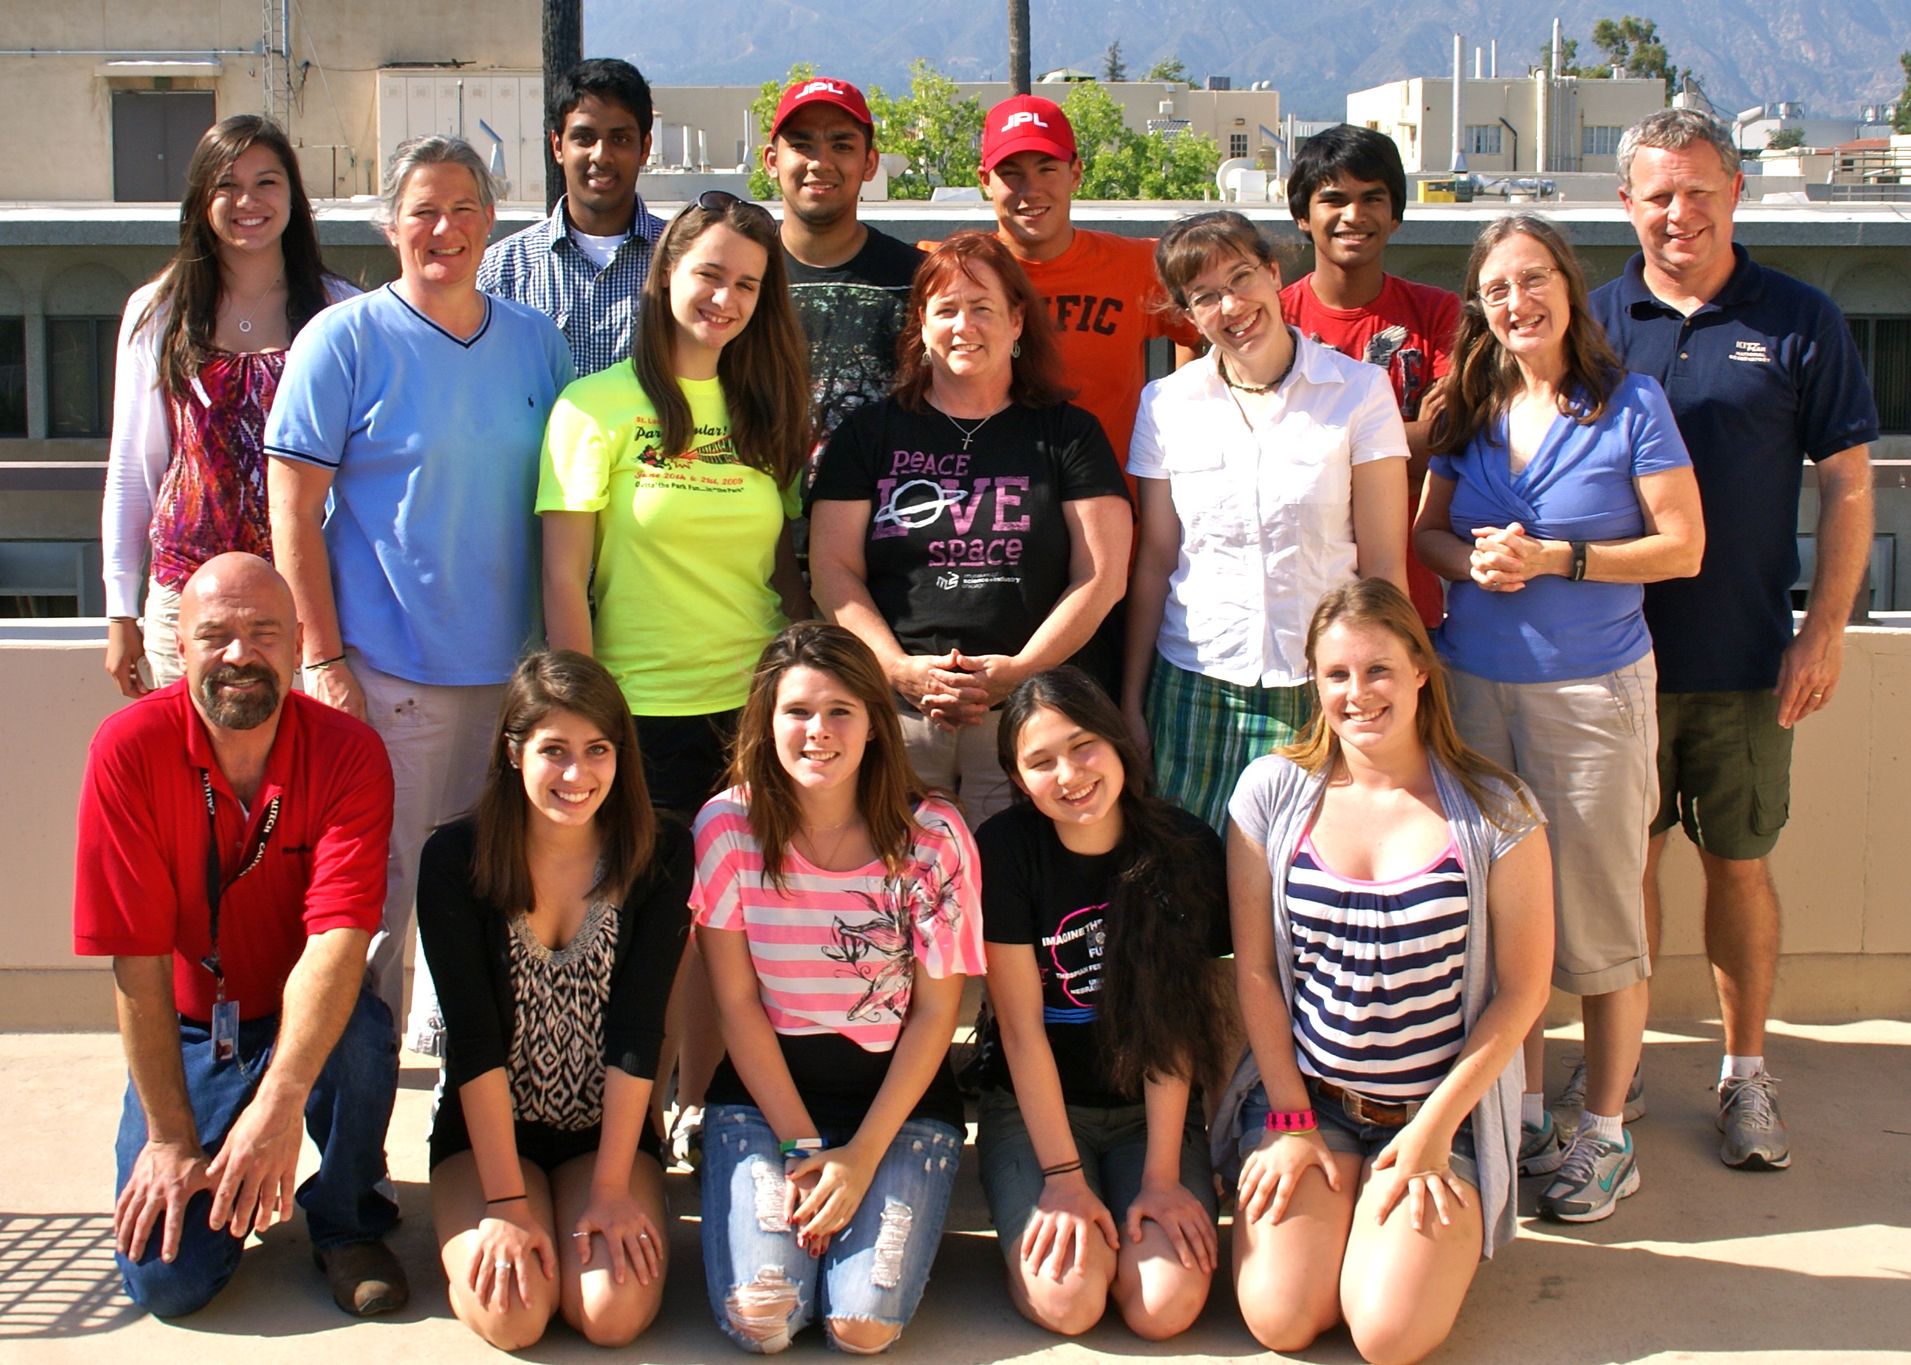
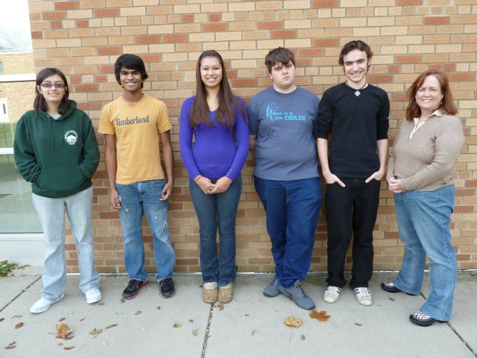
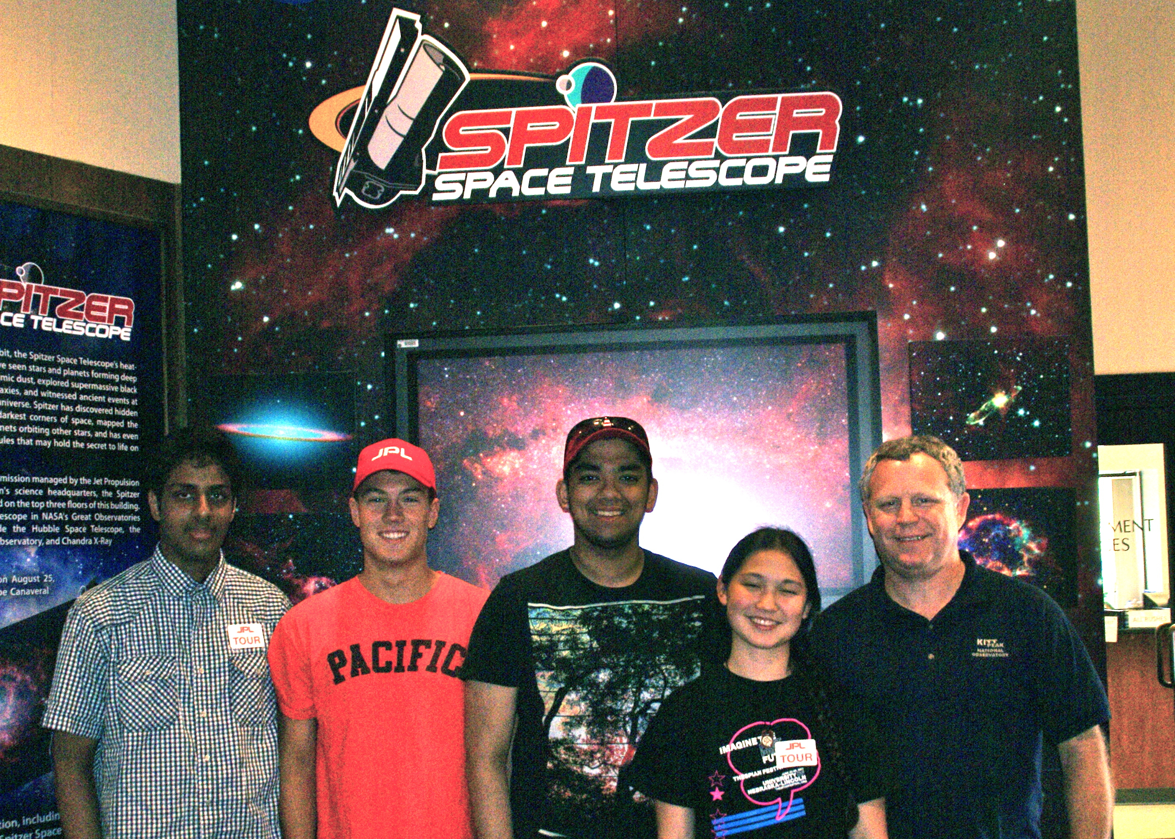
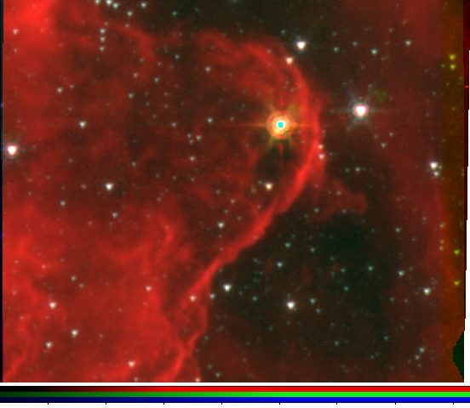
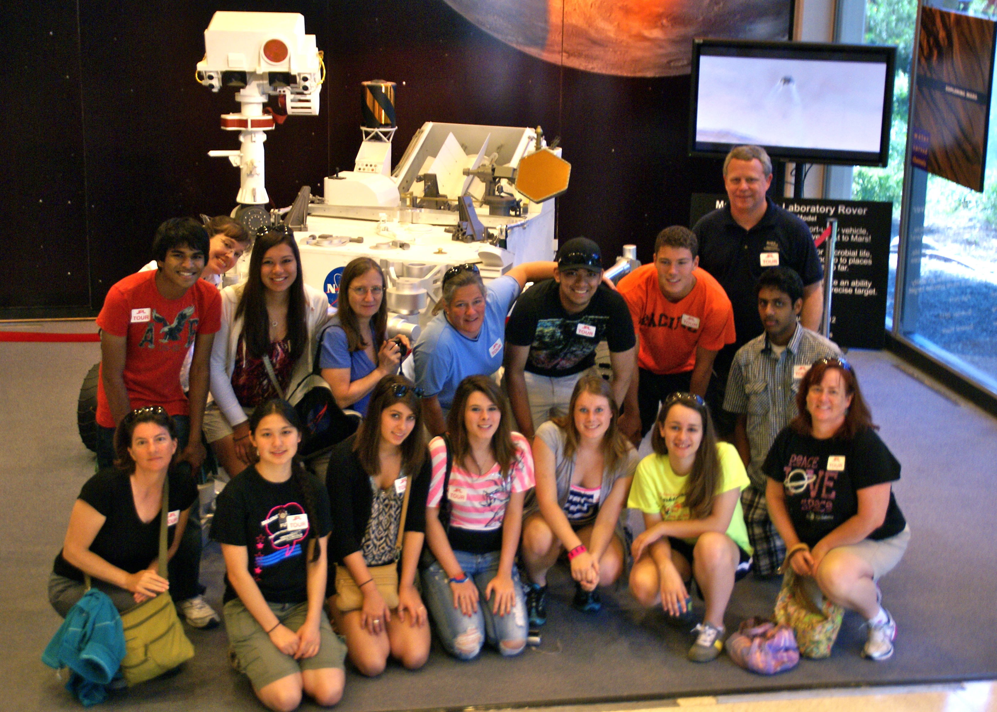
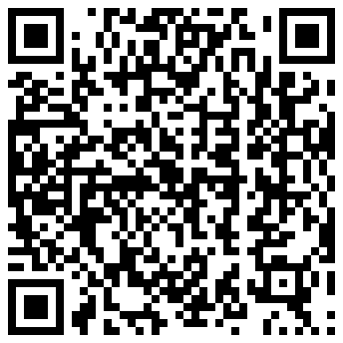
The Effect of an Authentic Science Research Experience on Teachers and Students through NITARP
Marcella Linahan¹, L. M. Rebull², C. H. Johnson³, J. C. Gibbs⁴, D. C. Sartore⁵, A. Rameswaram¹, H. N. Sprow¹, J. R. Fagan¹, A. Pullinger¹, N. J. Ezyk¹, T. Nuthmann⁴, T. Canakapalli⁴, S. Aryal⁴, M. Nishida⁴, N. G. Killingstad³, T. S. McCanna³, A. M. O'Bryan³, S. D. Carlson³, M. L. Clark³, S. M. Koop³, T. A. Ravelomanantsoa³, C. M. Tilley⁵, K. S. Badura⁵ ¹Carmel Catholic High School (Mundelein, IL), ²Spitzer Science Center/CalTech (Pasadena, CA), ³Breck School (Minneapolis, MN), ⁴Glencoe High School (Hillsboro, OR), ⁵Pine Ridge High School (Deltona, FL).
As part of the NASA/IPAC Teacher Archive Research Project program (NITARP), four high school teachers have participated with selected students in a research project using archival Spitzer data to search for young stellar objects in two bright-rimmed clouds: BRC 27 and BRC 34. Our scientific research findings are presented in another poster, Johnson et al. A key initiative in science education is integrating authentic scientific research into the curriculum. Since the NITARP program funds a limited number of teachers and students, our group has investigated the role of team leaders (both teachers and students) in educating and inspiring other teachers and students. This project allows our students to assume an active role in the process of project development, teamwork, data collection and analysis, interpretation of results, and formal scientific presentations. This poster presents our observations on methods used by student team leaders in disseminating the information to other students within the school, as well as to other local schools and interest groups. Since three of the four teachers on our team are female, we have also looked at how these teachers inspire young women to participate in this program and to pursue STEM (Science, Technology, Engineering, and Math) careers. This program was made possible through the NASA/IPAC Teacher Archive Research Project program (NITARP) and was funded by NASA Astrophysics Data Program and Archive Outreach funds.
Teacher
comments
Infrared versus visible light at the Jet Propulsion Laboratory
“I love real science. I think it’s better when you don’t know the answer; thus, you double check for human error constantly…However, in a high school science classroom everyone will reach the same conclusion because there is only one answer.”---A. Rameswaram
Observations
All the students felt that the teachers were patient and knowledgeable about the subject matter. Students believed that the teachers worked hard to guide and train students in the project.
All the students enjoyed the opportunity to work alongside their teachers. Students felt that teachers respected them and working with the teachers added to the authenticity of the project.
While students enjoyed the fact that the data was real data; it was also frustrating to make mistakes and to recalculate the data. However, the students appreciated that this is what real science is and were excited that they were actually contributing something to our understanding of young stellar objects.
All students felt that interaction between groups could be improved and would like to see an increase use of social networks in communicating between the groups.
“Each student brought a unique array of skills and knowledge; this allowed us to band together and to teach each other along the way. Without interacting with the other teams, I think the project would have been much more difficult.”---Florida #2
Team Minnesota
Team Florida
“I think the best part of the project was probably the atmosphere of it. Not only were we studying at Cal Tech, a place filled with so much intellectual curiosity and openness that it’s nearly palpable, but the warmth of the shared camaraderie between the teams made the experience so much better.”
---M. Nishida
Summer visit to Spitzer Space Science Institute
“The female mentors definitely inspired me to continue in a pursuit of majoring in science in college. I was inspired not only by the amount of knowledge and wisdom the female mentors, had but also the dedication they brought to their field and the passion they had for teaching high school students about their profession. I am now planning on pursuing a career in Aerospace Engineering with a minor in Astronomy.” T. McCanna
Bright-rimmed Cloud 34
Team Illinois
Team Oregon
Eighteen students participated in the NITARP research experience. Five of the students were male and thirteen students were female. Ten students were able to start their research experience with a summer visit to Caltech/Spitzer Space Science Institute for training. The remaining eight students were trained by the team leaders as well as the teachers involved in the project. Data was collected from a survey about their experiences.
For our research findings, please see the poster, ”Spitzer-Selected Young Stellar Objects in Two Bright Rimmed Clouds” by Johnson et al at this meeting.
We gratefully acknowledge funding via NASA Astrophysics Data Program funds and NASA/IPAC Archive Outreach funds.

