Slide 1
CM4SY
Looking for a Color-Luminosity Relationship for AGN
July 16, 2013
prepared by
Varoujan Gorjian
NITARP Scientist

Slide 2
An Image of the sky is essentially 2D

Slide 3
How Can we tell how far things are?

Slide 4
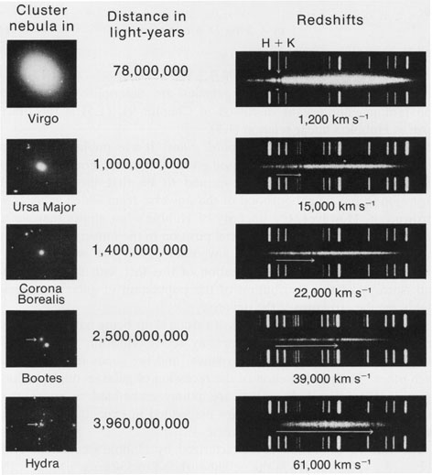
There is one way to get relative distance
Thanks to the Hubble law we can separate based on redshift:
V=H_{o}D

Slide 5
But which clusters are near and which ones are far?
Thanks to the Hubble law we can separate based on redshift:
V=H_{o}D

Slide 6
An Image of the sky is essentially 2D

Slide 7
The equivalent of a volcanic island is an Active Galactic Nucleus (AGN)

Slide 8
Quasars which are also Active Galactic Nuclei but more Luminous

Slide 9
Seyfert galaxies
are less luminous than
Quasars and so don’t outshine their galaxies.

Slide 10
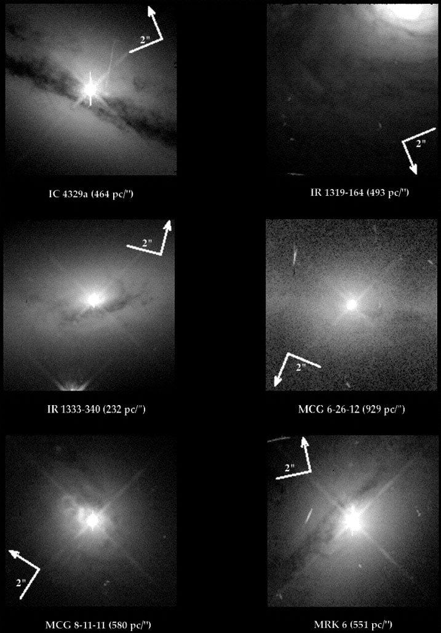

Slide 12
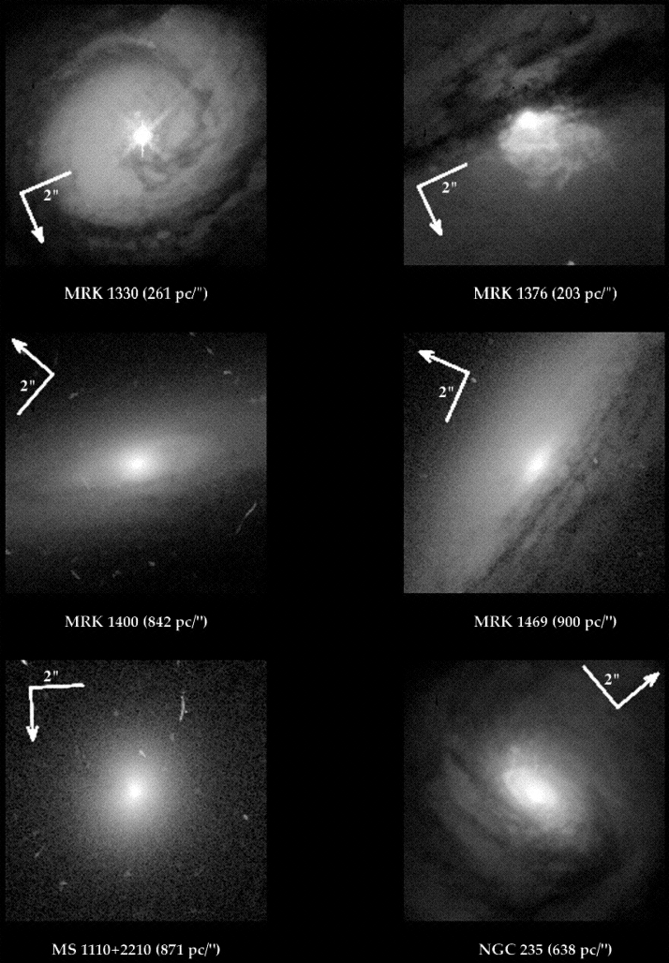

Slide 13
Our model for an Active Galactic Nucleus (AGN)

Slide 14
Spectrum of AGN Blue Excess (AKA Big Blue Bump)

Slide 15
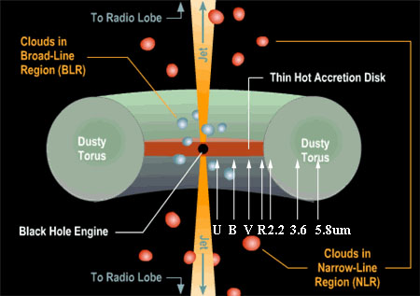

Slide 16
But how do we figure out how far away quasar is?
One way is to figure out its inherent luminosity and then compare it to its apparent luminosity because light follows the inverse square law:

Slide 17
This has been a very successful way of determining the distances to stars
How do we figure out the luminosity of a star?
This is the results of the Hertzsprung-Russell Diagram which relates the color of a star to it’s luminosity (also known as absolute magnitude)

Slide 18
Color Magnitude Diagram

Slide 19
Why does this work?
It’s based on simple physics of hot gasses:
Fusion creates energy at the core of a star
The energy then heats the outer gas layers of the star
What does heat have to do with luminosity?

Slide 20
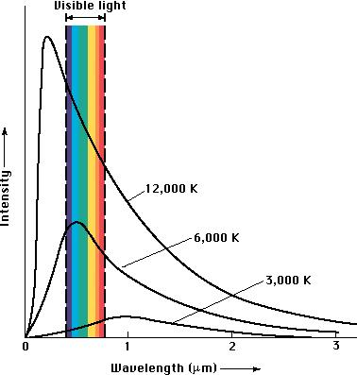
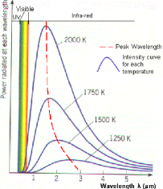
Black Body Radiation
The hotter something is, it emits more light.
20

Slide 21
Why does this work?
It’s based on simple physics of hot gasses:
Fusion creates energy at the core of a star
The energy then heats the outer layers of the star
What does heat have to do with luminosity?
SO THE MORE MASSIVE A STAR IS, IT HAS MORE FUSION AND GENERATES MORE ENERGY AND HEATS UP THE OUTER LAYERS OF A STAR MORE AND SO CREATES A MORE LUMINOUS STAR BECAUSE OF BLACK BODY RADIATION
Now how does that relate to the color of a star?

Slide 22
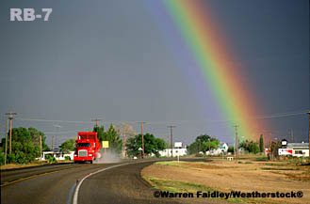
Color
Transmission →
Wavelength →

Slide 23
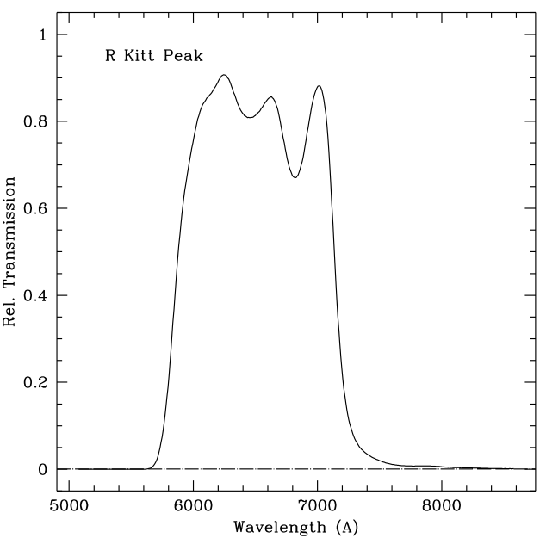
Color
Filter Transmission
This is KPNO R band.
Note that it’s not a “Top hat” function, but it’s trying.
Note also that none of it is perfectly transparent!
23

Slide 24
Color
The hotter something is, it emits more more short wavelength light
24

Slide 25
Color
So what temperature are these galaxies?
25

